Slide 1
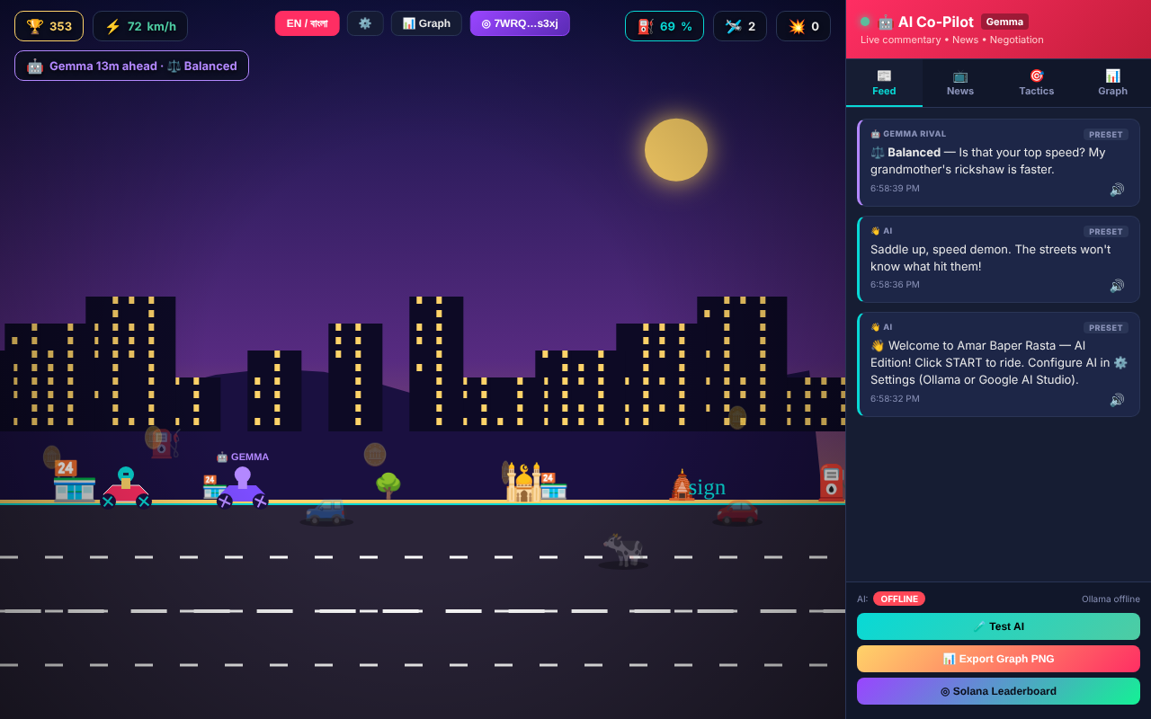
MLH SOLANA HACKATHON · GAMING + AI TRACKS
আমার বাপের রাস্তা
AMAR BAPER RASTA
A Dhaka street-racing game. Gemma tells the story. Solana keeps the receipts.
Jabir Sharif
Team One Man Army
Notes:
This is Amar Baper Rasta, a street-racing game set on a chaotic Dhaka road. You dodge rickshaws, cows and potholes while Gemma, our AI co-pilot, narrates the ride. For this hackathon we added Solana, so every run can be stamped on-chain.

Slide 2
Arcade high scores are trust-me numbers
THE PROBLEM
They live in someone’s database. Players can’t prove a run happened, and the leaderboard disappears when the server does.
USUAL GAME
AMAR BAPER RASTA
A server you have to trust
A transaction anyone can check
Scores can be edited, wiped or faked, and nobody outside can check.
Each run is signed by the player’s wallet and stored on Solana for good.
Amar Baper Rasta · MLH Solana Hackathon
2
Notes:
Game scores usually sit in a private database. You can't prove your run happened, and anyone with access can edit the board. We wanted every run to be a signed record that anyone can check.

Slide 3




The game: Dhaka traffic, narrated by AI
Dodge rickshaws, cows, buses and potholes, and fly over traffic
Gemma writes live headlines and roasts every crash
Police and mob stops where your reply changes the game
Race Gemma Rival, or up to five friends online
Amar Baper Rasta · MLH Solana Hackathon
3
Notes:
The base is a browser arcade game on a Dhaka street. Gemma, an open-weight AI model, is the co-pilot: it writes satirical headlines, runs police and crowd negotiations that change the game, and picks the AI rival's racing strategy. It runs in any browser with no install.

Slide 4




What we built on Solana this weekend
Wallet connect
Run receipts
Phantom, Solflare, Backpack, or a one-click burner wallet.
One signed transaction stores score, stats and Gemma’s headline.
On-chain leaderboard
Signer check
Global top 10 read straight from devnet. No backend, no database.
A score counts only if the wallet named in it signed it.
Amar Baper Rasta · MLH Solana Hackathon
4
Notes:
Four things are new this weekend. Players connect Phantom, Solflare or Backpack, or make a burner wallet in one click so judges can try it without installing anything. At game over, one signed transaction stamps the run. The leaderboard is read directly from the chain, and every top entry is checked against the wallet that signed it.

Slide 5

How a run reaches the chain
STEP 2
STEP 3
STEP 4
STEP 5
STEP 1
Wallet signs one transaction
Play a run
Gemma writes the headline
Lands on Solana devnet
Board reads and verifies
One call to read
Then a check
getSignaturesForAddress on the leaderboard address returns every run’s memo at once.
The top 10 are re-read with getParsedTransaction: the claimed wallet must be the signer.
Amar Baper Rasta · MLH Solana Hackathon
5
Notes:
Here is the flow. You play, Gemma writes your headline, your wallet signs one transaction, and it lands on devnet. To build the leaderboard, the browser makes one RPC call that returns every run's memo, then re-checks the top ten so only runs signed by the wallet they name are counted.

Slide 6
One transaction, three instructions
# | Instruction | Why it’s there
1 | Compute Budget: limit 400,000 CU | Bangla headlines cost about 450 CU per byte
2 | System transfer: 0 SOL to the leaderboard address | Indexes the run under one address; moves no money
3 | SPL Memo, signed by the rider | Holds the run as JSON: score, stats, wallet, AI headline
The leaderboard address is a PDA derived from a fixed seed, so nobody holds its key.
Amar Baper Rasta · MLH Solana Hackathon
6
Notes:
Each receipt is one legacy transaction. The compute-budget instruction exists because Bangla text is expensive for the Memo program. The zero-SOL transfer moves no money; it just makes the run show up under the leaderboard address. The memo carries the run itself. The leaderboard address is a program-derived address, so nobody can control it.

Slide 7
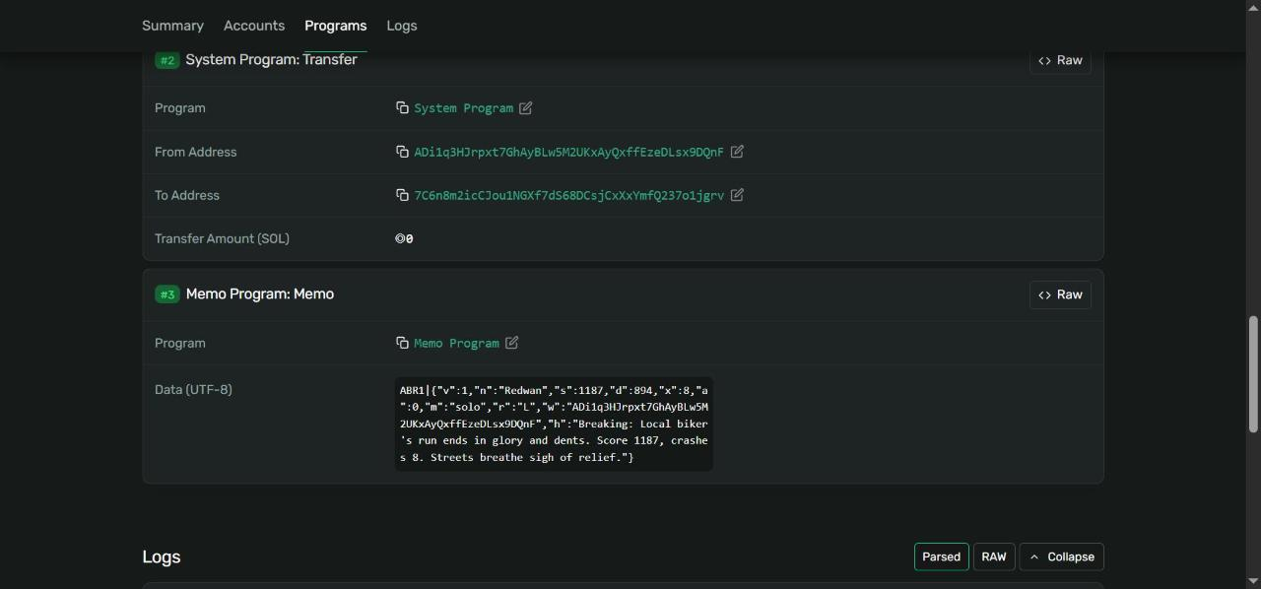
Proof: a real run, finalized on devnet
Finalized
Status: success
◎0.000005
Network fee per run
99,178 CU
Used of a 400,000 limit
530 bytes
Of the 1,232-byte maximum
Solana Explorer · tx 5Kik…K16p · Nov 8, 2026
Amar Baper Rasta · MLH Solana Hackathon
7
Notes:
This is a real run from the live site, stamped on devnet tonight. Explorer shows it finalized, with the run JSON in the memo: score 1187, eight crashes, and Gemma's headline. The fee was 0.000005 SOL, and it used about a quarter of the compute limit.

Slide 8
What broke, and how we fixed it
Problem | Fix
Long Bangla headlines ran out of compute | Measured the cost, raised the limit to 400k, capped memos at 520 bytes
Anyone can write a memo naming any wallet | Check the named wallet is the signer; drop fakes before ranking
The public devnet airdrop is closed | Copy the address, link the web faucet, watch until the SOL lands
Wallet set to the wrong network | Sign in the wallet, send through our own devnet connection
Amar Baper Rasta · MLH Solana Hackathon
8
Notes:
Four real problems came up. Bangla headlines blew the Memo program's default compute budget, so we measured it and raised the limit. Memos can claim any wallet, so we verify the signer and drop forgeries. The public devnet airdrop is shut, so the game now guides players to the web faucet and watches for the SOL. And wallets on the wrong network fail, so we sign in the wallet but send through our own devnet connection.

Slide 9


Built for the Gaming and AI tracks
Gaming
AI
A full arcade game where Solana is part of the loop: finish a run, stamp it, climb a board nobody can quietly edit.
Gemma narrates every run, steers the rival, and writes the headline that becomes a permanent on-chain record.
Amar Baper Rasta · MLH Solana Hackathon
9
Notes:
We're entering the Gaming and AI tracks. For gaming, Solana sits inside the play loop rather than beside it. For AI, the model's output isn't just flavour text: Gemma's headline becomes part of each permanent on-chain receipt.

Slide 10
What’s next
01
02
03
Real anti-cheat
Trophies
Rewards and races
An Anchor program that only accepts runs co-signed by a referee that replays the seeded road.
Compressed NFTs for every #1 finish.
SPL “Taka” tokens for coins, and wagered rooms with on-chain escrow.
Amar Baper Rasta · MLH Solana Hackathon
10
Notes:
Today the chain proves who submitted a run and when, but not that it was played fairly. The next step is an Anchor program that only accepts runs co-signed by a referee that replays the seeded road. After that: NFT trophies for winners, and token rewards and wagered races.

Slide 11



Try it now
Play
starbucksat4thave.github.io/Baper-Rasta-Solana
Code
github.com/starbucksat4thave/Baper-Rasta-Solana
Proof tx
Solana Explorer · devnet · 5Kik…K16p
Presented by Jabir Sharif · Team One Man Army
Base game by Crack Platoon (Shoriful Islam, Jabir Sharif, Ekramul Islam, Md Tasnimul Hasan, Ishtiaq Mahmud) at Hacktoberfest Hack Day. Solana layer built during the MLH Solana Hackathon, Nov 6–8, 2026. MIT licensed.
Amar Baper Rasta · MLH Solana Hackathon
11
Notes:
Everything is live. Open the game link, pick the burner wallet, grab free devnet SOL from faucet.solana.com, play, and stamp your run. The code is open on GitHub, and the Explorer link shows tonight's test run.

Slide 12
Gemma tells the story. Solana keeps the receipts.
আমার বাপের রাস্তা
Jabir Sharif · Team One Man Army · MLH Solana Hackathon
Notes:
Amar Baper Rasta: Gemma tells the story, and Solana keeps the receipts. Thank you.

